Slide 1

UNIX - Fundamentals
7
Simple Filters
9
SED
5
The shell
cmp comm diff head and tail …
Inserting
Updating
Deleting
RegEx….
1
UNIX Intro
3
Unix File System
Pattern matching
Escaping Redirecting…
The UNIX OS
The Linux OS
Features of Unix
The file
pwd and cd
mkdir
ls and cp ..
Shell Programming
8
GREP
10
6
The Processes
The character class
The *
The Dot…
condition eval
loops
read
exit status
4
Vi/Vim editors
ps nohup at and batch
2
Unix Commands
Input mode
Saving text
Aborting…
command basics
man
echo
printf …
Biz Nigatu
Software Engineer and Instructor
reckonedforce.com
@bizNigatu

Slide 2
Section 8 – UNIX Fundamentals
grep: Searching for a Pattern
grep Options
Basic Regular Expressions
Extended Regular Expressions
sed: The Stream Editor
Line Addressing
sed Options
Context Addressing
Writing Selected Lines to a File (w)
Text Editing, Updating (i, a, c) Deleting (d) lines
Substitution (s)

Slide 3
Chapter 10 - *** GREP and SED

Slide 4
‘grep’ Command
The ‘grep’ (generalized regular expression parser) command is used to search text
It searches a given file for lines containing a match to the given strings or words
It is one of the most useful commands on Linux and Unix systems

Slide 5
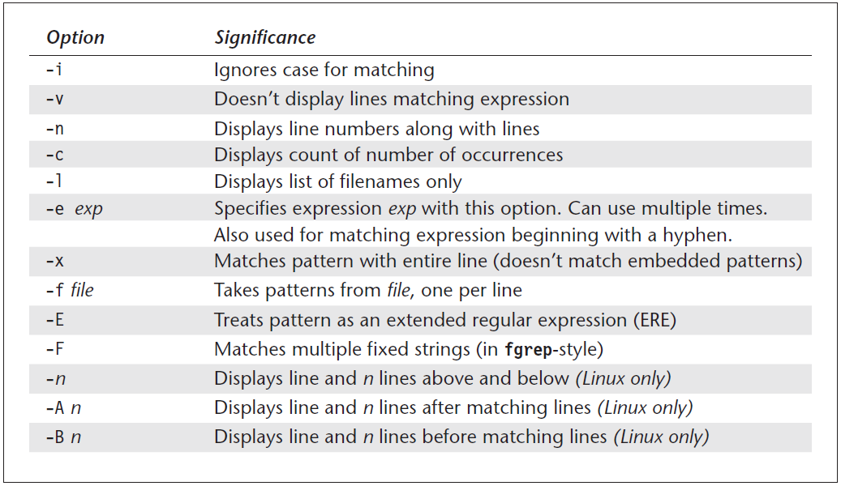
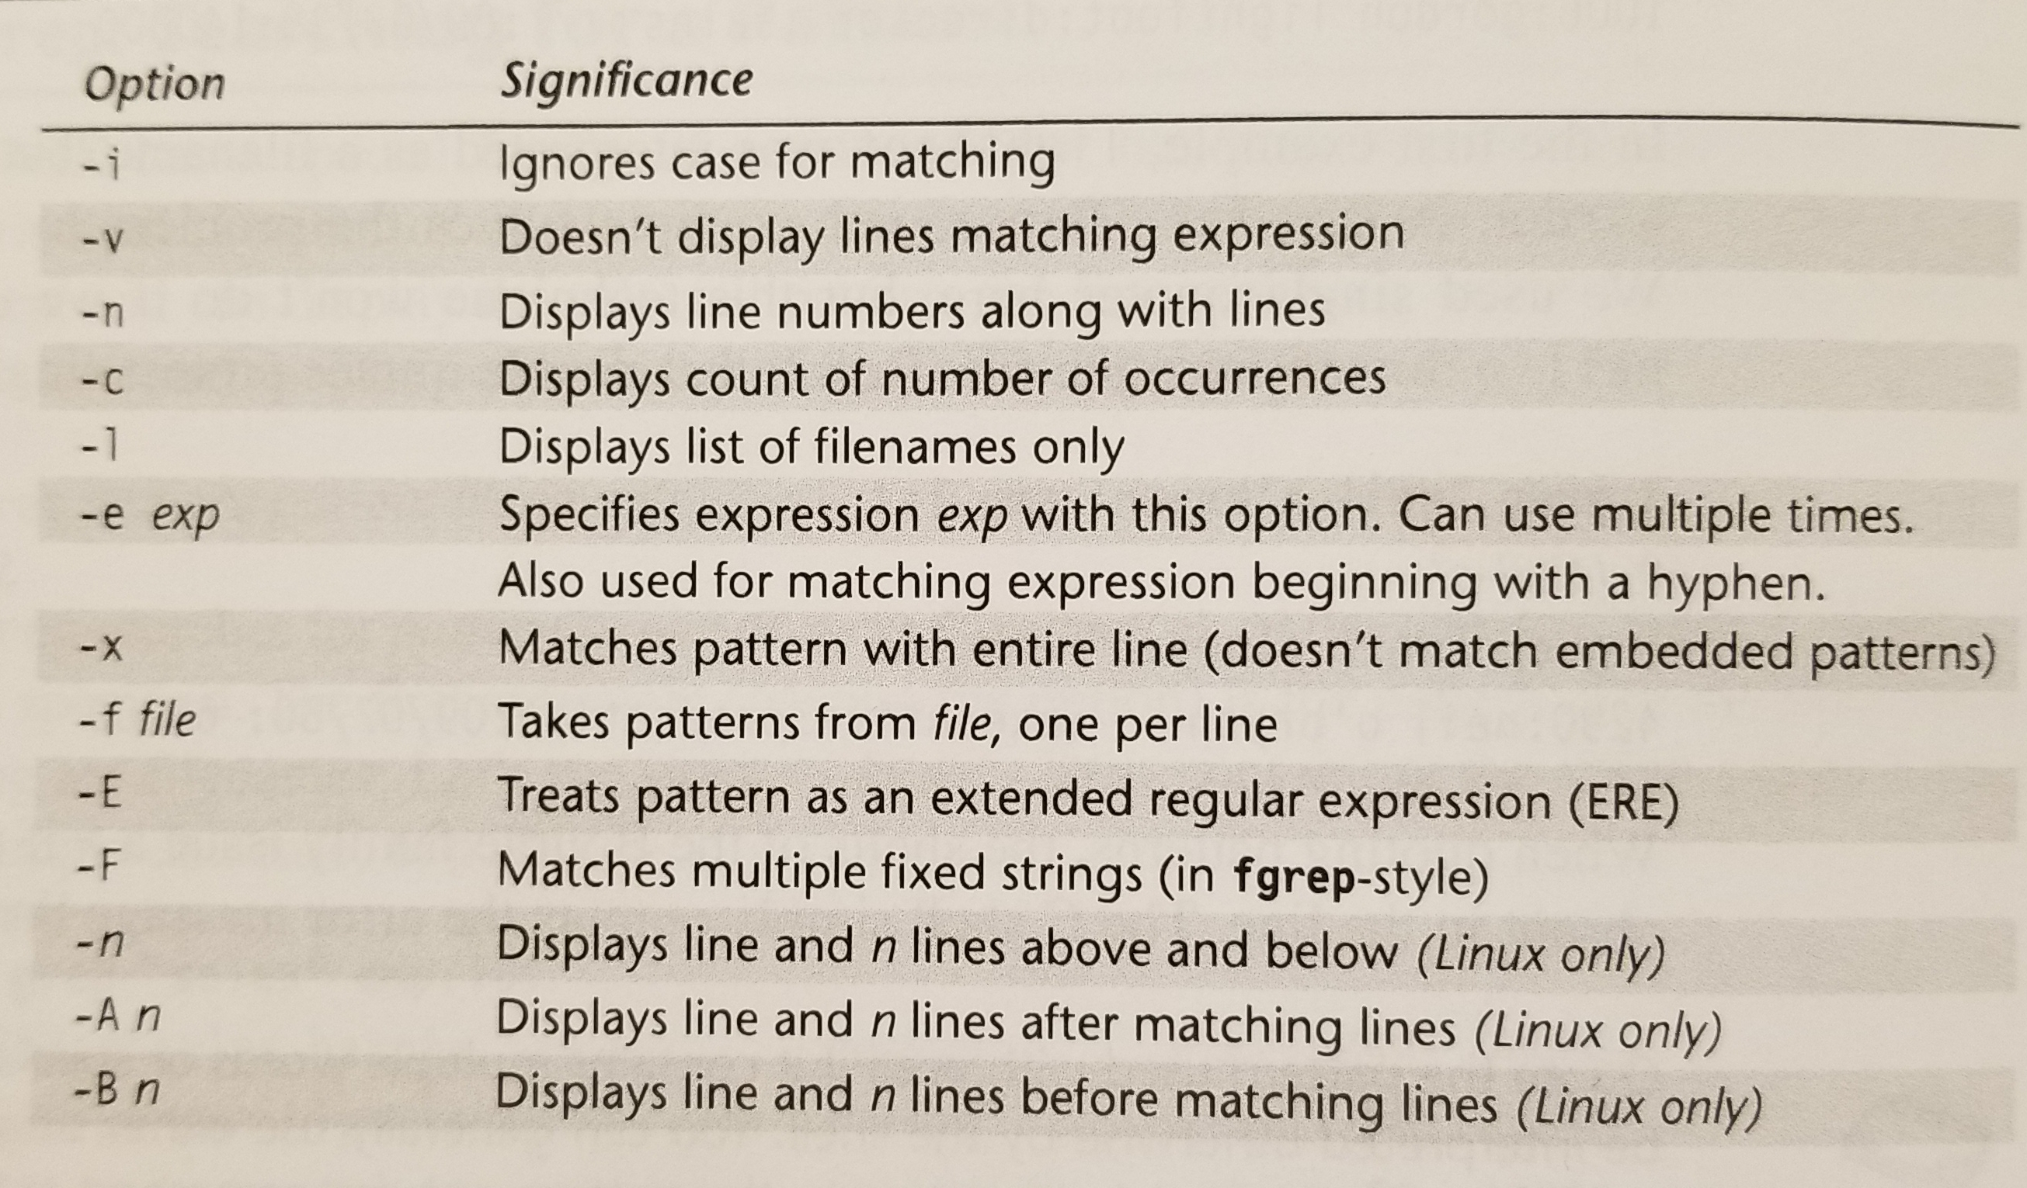
‘grep’ Options

Slide 6
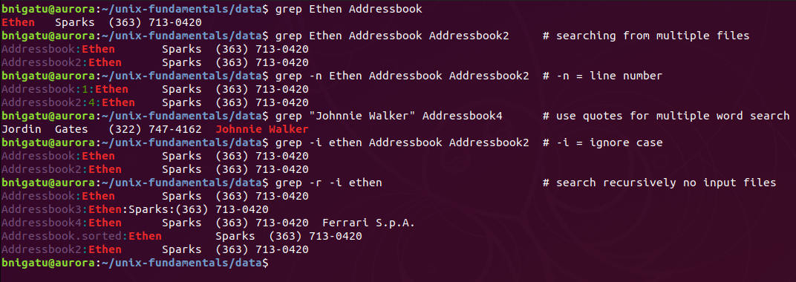
‘grep’ Command Continued
Quoting the pattern is not necessary for single word patterns. However, for multiword patterns, quoting is required.

Slide 7
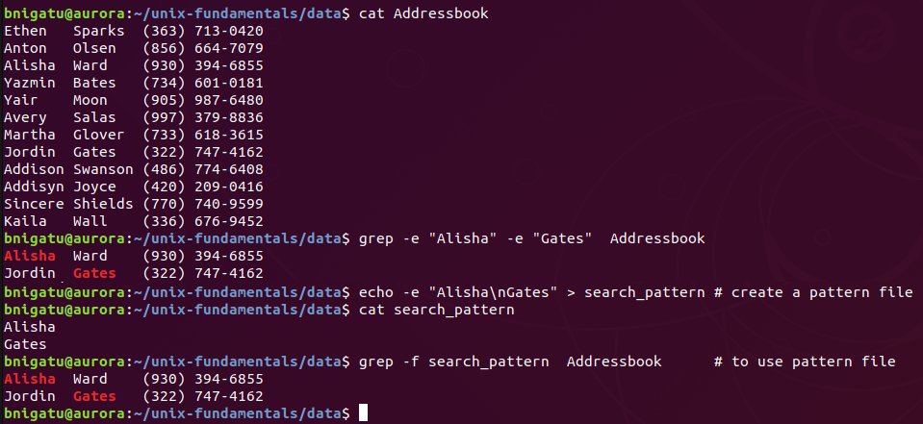
‘grep –e’ and ‘grep –f’ Commands
use ‘grep –e’ to search for multiple words at the same time. You must use ‘-e’ before EACH search pattern.
Use ‘grep –f’ to search using a pattern file.

Slide 8
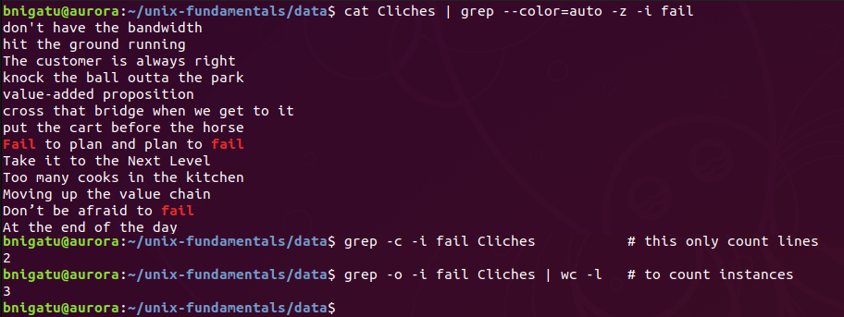
‘grep –c’ Command
The ‘-c’ option counts the number of lines of the pattern were found. This is not how many instances were found.
Line 1
Line 2
2 lines

Slide 9
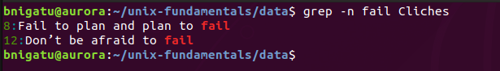
‘grep –n’ Command
Same as –w but provides the line number in the front where the pattern was found.

Slide 10
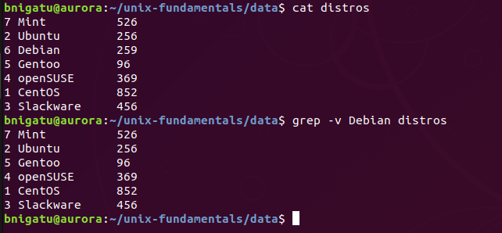
‘grep –v’ Command
In the image above, there are four lines. The ‘-v’ option says print all lines NOT CONTAINING the pattern.
Debian is removed

Slide 11
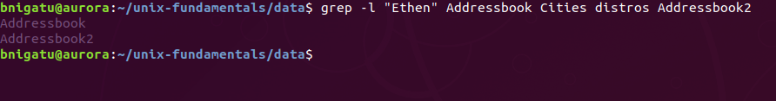
‘grep –l’ Command
The ‘-l’ option to search over multiple files that contain the grep expression.

Slide 12
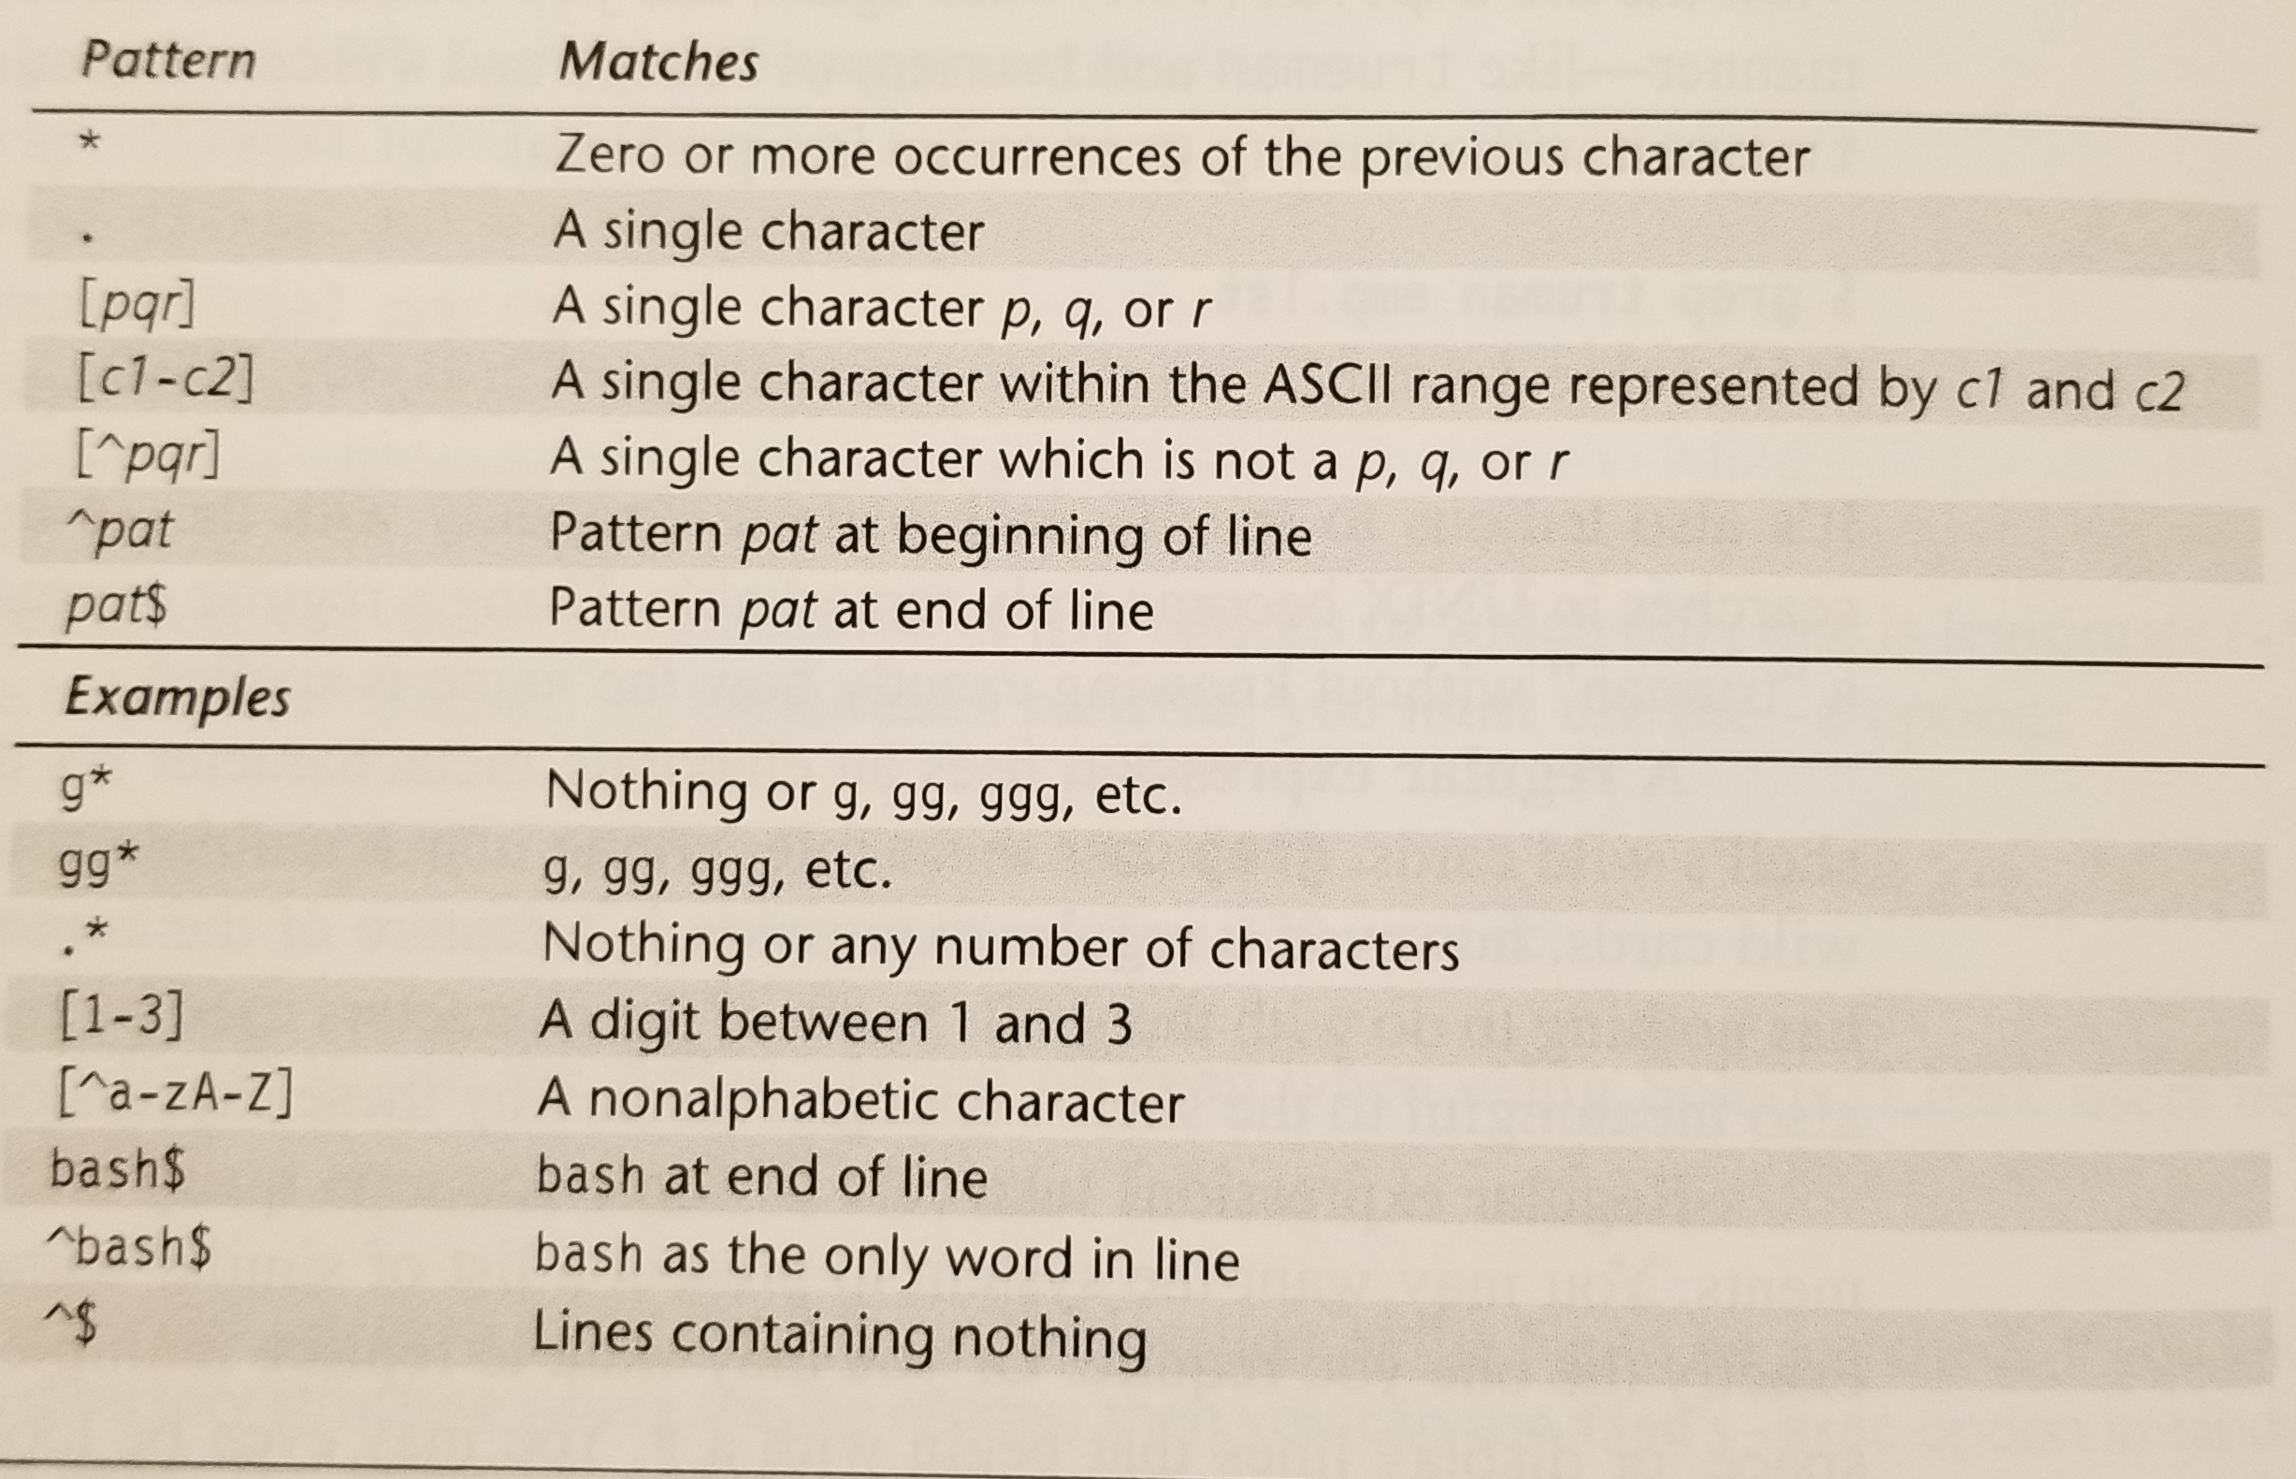
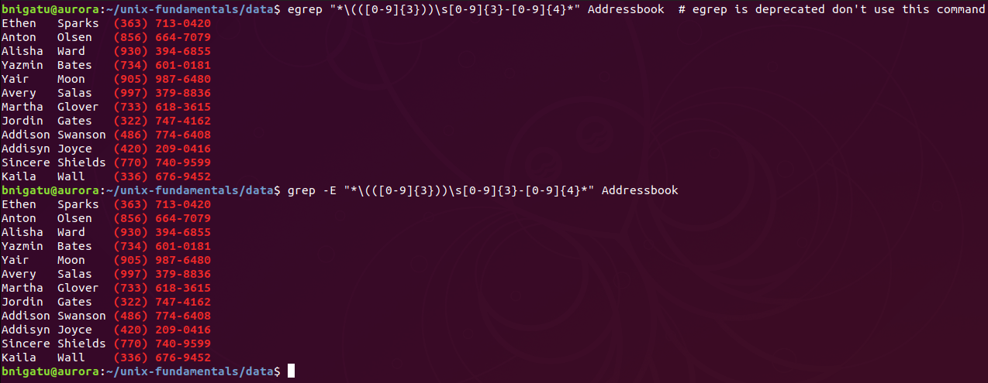
‘grep –E’ with Basic Regular Expressions
Example: Regex to search for phone number grep -E "*\(([0-9]{3}))\s[0-9]{3}-[0-9]{4}*" Addressbook

Slide 13
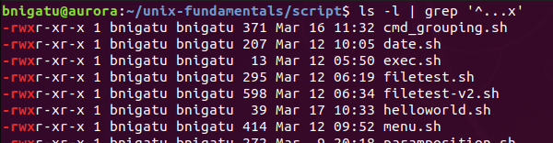
‘grep’ with Basic Regular Expressions
Find all executables files or files that have the fourth column as ‘x’.
The ‘^‘ says start at the beginning.

Slide 14
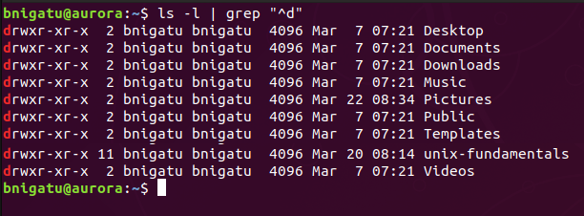
‘grep’ with Basic Regular Expressions
Show only directories. The “^d” means start at the beginning and display only files with a ‘d’ at the front.

Slide 15
‘grep –E’ with Extended Regular Expressions
Try using grep to search for a pattern with ? – won’t work. You need to use ‘-E’ to gain access to the “extended” set that includes ‘?’ and ‘+’. In order to use the ‘-E’, your UNIX/Linux must be POSIX-compliant. Linux grep supports this option.
Example: Regex to search for phone number grep -E "*\(([0-9]{3}))\s[0-9]{3}-[0-9]{4}*" Addressbook

Slide 16
SED – the Stream Editor

Slide 17
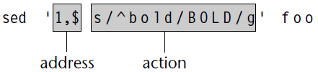
‘sed’ Command
Combines work of several filters
Operates on noninteractive operations on a data stream
Has very few options
Good preparation for Perl which uses many of sed features
Uses instructions to act on text
‘sed’ syntax:
‘sed options ‘address action’ file(s)’
Addressing done in one of two ways:
By one or two line numbers (like 3,7)
By specifying a /-enclosed pattern which occurs in a line (like /From:/)
Processes in a sequential order

Slide 18
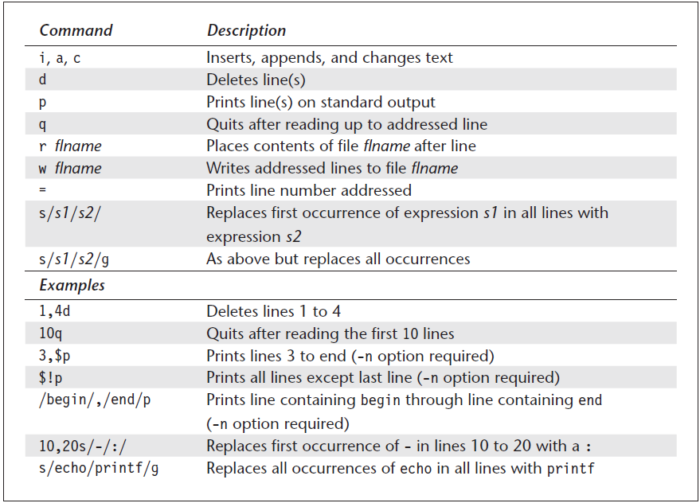
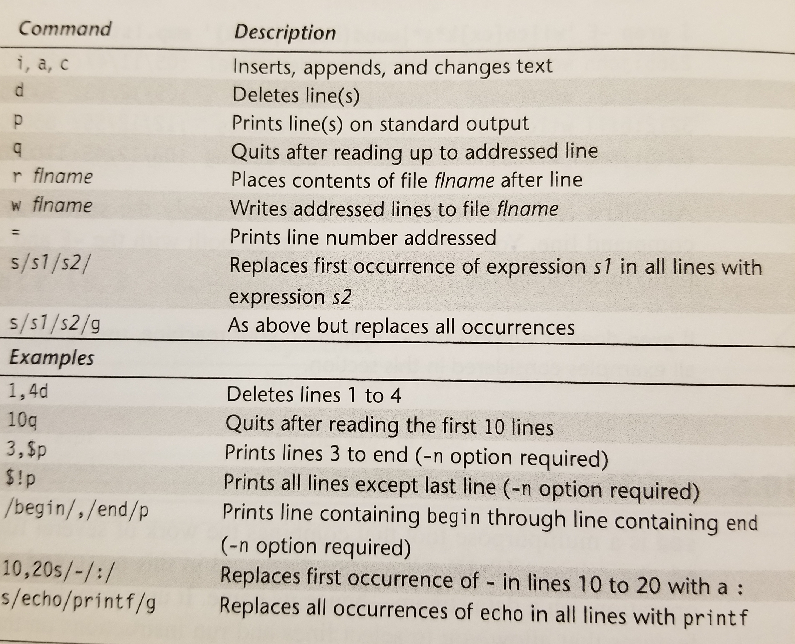
‘sed’ Internal Command

Slide 19
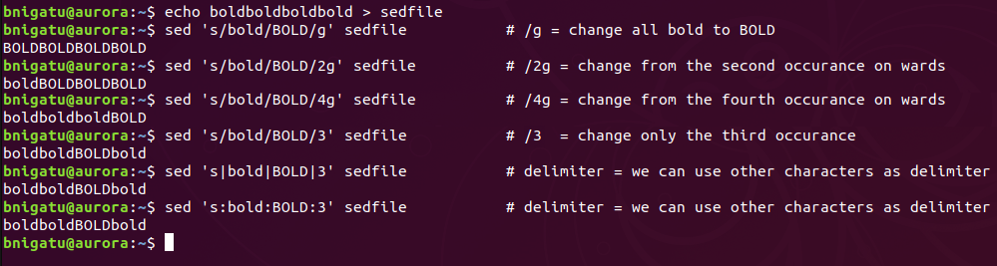
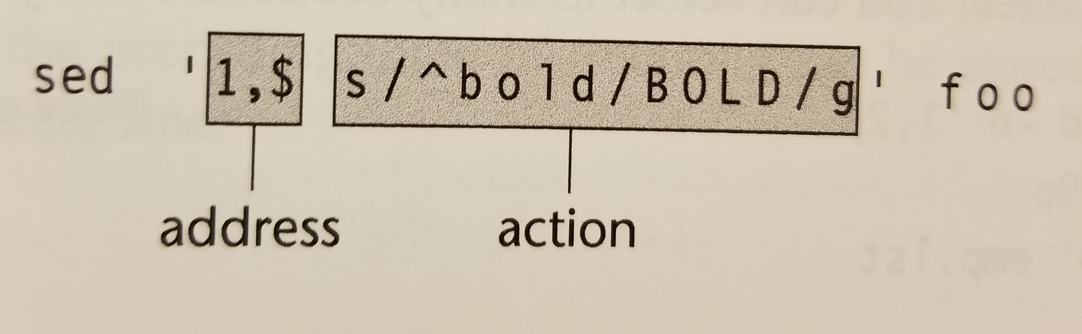
‘sed’ Syntax

Slide 20
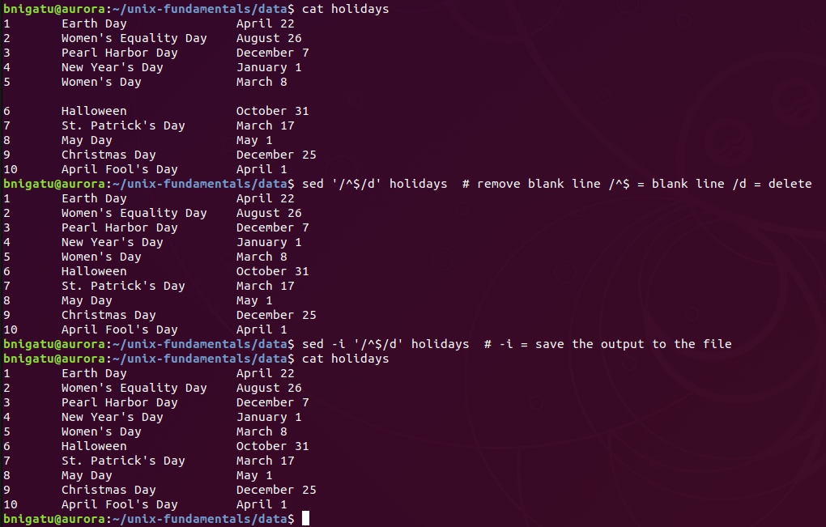
‘sed’ Example

Slide 21
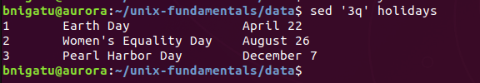

‘sed’ Line Addressing
Prints out the holidays but quits ‘q’ after the third line ‘3’, e.g. ‘3q’
‘3’ is the address and ‘q’ is the action; this simulates ‘head –n 3’
‘3,5p’ = print (‘p’) out lines 3-5 from file ‘holidays’
The ‘-n’ is necessary when using ‘p’ to prevent duplicate displays

Slide 22
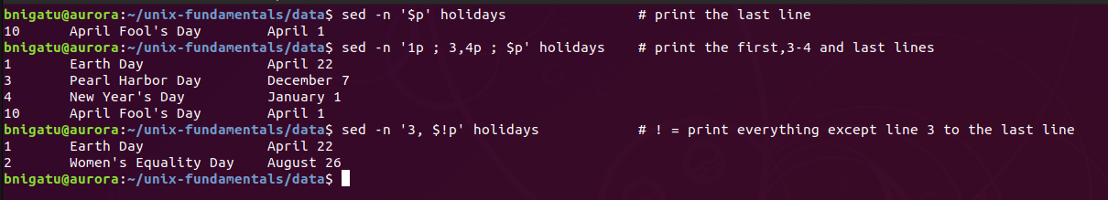
‘sed’ More Printing
“sed –n ‘$p’ holiday” - the ‘$p’ says print the last line only
To print multiple lines from anywhere use ‘;’ e.g. “sed –n ‘1p ; 3,4p ; $p’ holiday” – each instruction separated by a ‘;’. This is good with Linux but not with Oracle Solaris.
Use the ‘!’ negation operator to print lines other than specified for sed e.g. “sed –n ‘3,$!p’ users” which is don’t print lines between third and last lines.
Example: (See below)

Slide 23
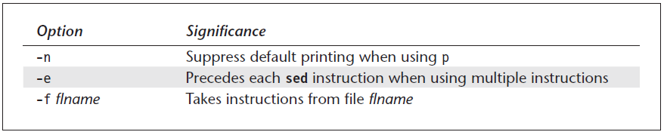
‘sed’ Options
POSIX requires sed to support only three options (-n, -e, and -f).
-n = is covered earlier with p, which was used to suppress duplicates
We will show an example next, for -e = how to specify multiple instructions for sed, and -f = how to use instruction file for sed

Slide 24
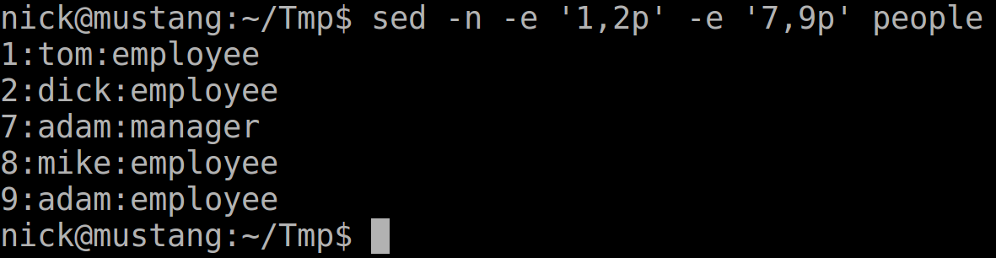
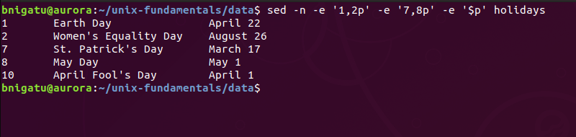
‘sed’ with Multiple Instructions -e
This example doesn’t do any more than “sed –n ‘1,2p ; 7,8p ; $p’ holidays”; however, as you become more accustomed to using ‘sed’ and use more complicated instructions, the ‘-e’ may become more apparent.

Slide 25
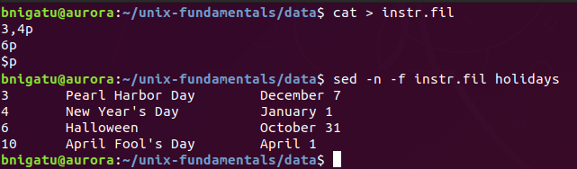
‘sed’ with Instructions File : -f
‘sed’ can receive its instructions from a file you created
‘instr.fil’ :
3,4p print lines 3-4
6p print line 6
$p print last line
‘sed –n –f instr.fil holidays’ – you can also combine –n –f into ‘-nf’

Slide 26
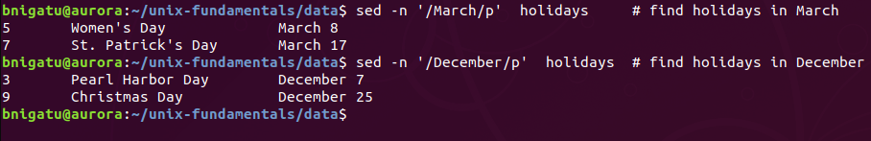
‘sed’ Second Form of Addressing
You specify a pattern (or two) rather than line numbers
Known as context addressing
The pattern has a ‘/’ on either side of the pattern

Slide 27
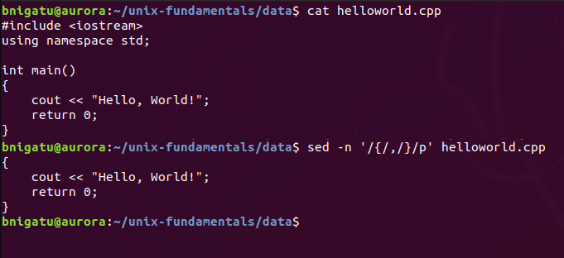
‘sed’ Comma-Separated Pair
EXAMPLE: “sed –n ‘/{/,/}/p’ helloworld.cpp” to extract the body of the main function
This is the same as, .
“sed –n ‘5,8p’ helloworld”.

Slide 28
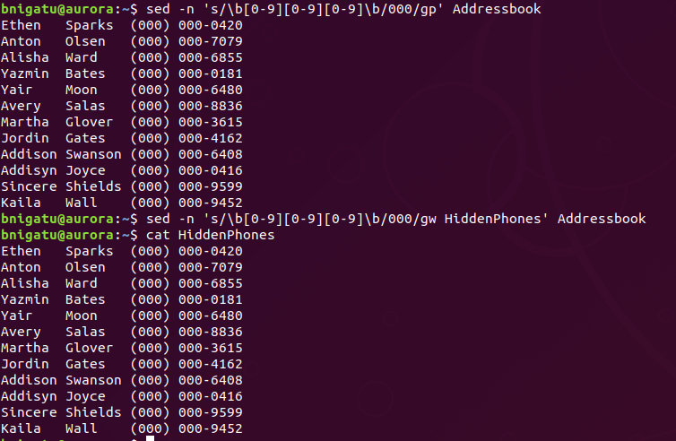
‘sed’ (w) Writing Selected Lines to a File
Irrespective of the way you select lines (by line or context addressing), you can use the w (write) command to write the selected lines to a separate file.
Example: We are asked to provide an Addressbook that only shows the last 4 digits of our customers. /w filename saves the output to a new file.
p= print output
g= apply to all
w= output to file
g= apply to all

Slide 29
Text Editing using ‘sed’
Commands used in a vi text editor are the same as sed — i (insert), a (append), c (change), and d (delete).
Substitution is the most important feature of sed, and this is one task that sed does exceedingly well.

Slide 30
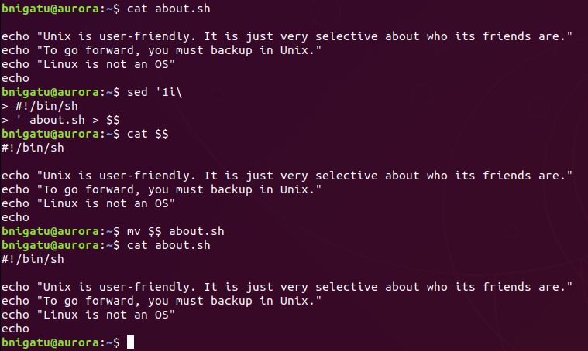
‘sed’ to insert a text
Original script without a shebang
The i\ command inserts text.
The example shows how to insert a shebang at the first line of a shell script
This will insert shebang at line 1
Use this to temporarily store the file
To check the temp file is good
If everything is good replace the script with temp file

Slide 31
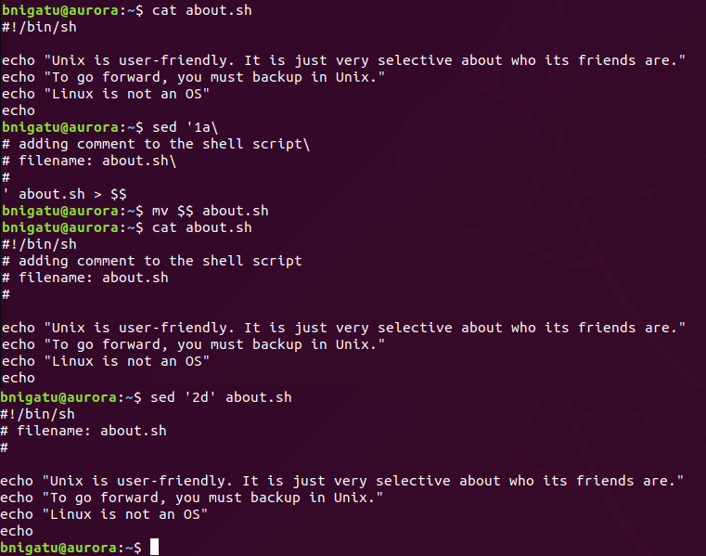
‘sed’ to append a\ and delete d\
Original script without a comment
The a\ command appends text.
The d\ command deletes a line
The example shows how to append a comment at the first line of a shell script.
It also shows how to deleted the second line from the script.
Adding comment
The append output
This deletes the second line

Slide 32
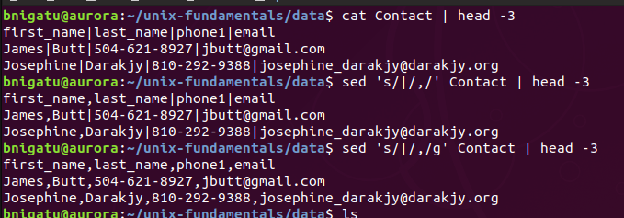
‘sed’ for text substitution s/
Sed substitution works as follows “sed ‘s/expression1/expression2/flags’ filename”
It only updated the first occurrences
If no command specified
g= global

